Slide 1
SOURCE CODE CONTROL
COMP220/285
© University of Liverpool
slide <number>

Slide 2
Code Management
Have you ever?
  Made a change to code, realised it was a mistake and wanted to go back?
  Lost code or had a backup that was too old?
  Had to maintain multiple versions of a product?
  Wanted to see the difference between two (or more) versions of your code?
  Wanted to prove that a particular change broke or fixed some piece of code?
  Wanted to submit a change (patch) to someone else's code?
  Wanted to see how much work is being done (where/when/who)?
  Wanted to experiment with a new feature without interfering with working code?
COMP220/185
© University of Liverpool
slide <number>

Slide 3
What does it do?
Provides safe access to files of any sort but initially designed for source code
Allows you to track the changes in a file or document (control the versions)
Allows you to go back to previous versions
Allows you to view what modifications were made to a file between versions
Provides locking/merging facilities
COMP220/185
© University of Liverpool
slide <number>

Slide 4
Which source code tool
Not Visual Source Safe
  Repository corruption, no atomic commits
svn
  Widely used and good tool support, example tortoise svn
Git
  Distributed architecture (clones of central repository stored locally)
  Faster, less server bound than svn
  Merging is better
  Complex and powerful, sometimes hard to learn
Perforce
  Commercial product
  High performance for large projects
COMP220/185
© University of Liverpool
slide <number>

Slide 5
Subversion in this subject
Had to pick one
Widely used
Fairly easy to understand model
Very good free booking on svn
  svnbook.red-bean.com
Note most of the principles/techniques also apply to other source code alternatives
COMP220/185
© University of Liverpool
slide <number>

Slide 6
Source code control Rule 1
If it’s not in source control it doesn’t exist
If it’s one your local machine, that code will be gone as soon as someone steals it from your house/flat/apartment… gone forever
So commit your code!
COMP220/185
© University of Liverpool
slide <number>

Slide 7
Concepts
Revision
  A particular version of a particular file
Working copy
  A copy of the file on your system
Update
  Download a revision of a file to your machine, which you can read/edit
Commit
  Write file(s) back to the repository, this process generally creates a new revision of the file or files
COMP220/185
© University of Liverpool
slide <number>

Slide 8
Working copies
Local copies of the file
Can be different from the controlled version
Based on a revision “checked out” from the repository
Each working copy has
  Timestamp of last update, revision id
File can be
  Unchanged and current
  Changed and current
  Unchanged and out-of-date
  Locally changed and out-of-date
COMP220/185
© University of Liverpool
slide <number>

Slide 9
Problems with shared source code
Alice make’s change to file Person.java, e.g.
  int min_age=18;
Bob make’s change to file Person.java,
  int min_age=21; // same line
Alice then writes her modifications back to repository
Bob then writes his modifications back to repository
Alice’s modifications are lost!!
COMP220/185
© University of Liverpool
slide <number>

Slide 10
Problem with lost updates
If this was a conventional file system, Alice’s modifications would be lost and worse nobody might know this!
Source code sharing solutions
  Locking
    Only 1 user gets a copy of the file to edit at once
  Shared writing and merging
    2 user’s get a copy and the file modifications are merged together
COMP220/185
© University of Liverpool
slide <number>

Slide 11
Basic source control operation
Setting up repository
  Use import to copy files into repository
Getting new working copies
  Use checkout
Update/edit/commit
  Update ensures you have the latest copies
  Edit
  Commit your changes
COMP220/185
© University of Liverpool
slide <number>

Slide 12
File locking “lock-modify-unlock”
Alice updates file Person.java and locks it for edit
If Bob does an update on the file, he won’t be able to modify it (it will be read only) (the working copy might be modified but write back to the repository will be denied)
Later after Alice has committed her changes, Bob can try and check out for edit and he will get the file with her modifications in
Now Bob can decide if he want’s to write over Alice’s modifications or chat with her to decide what to do
COMP220/185
© University of Liverpool
slide <number>

Slide 13
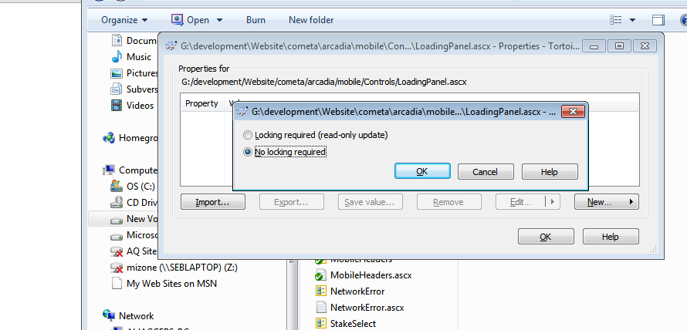
How to force locking
In svn set the read-only update property
COMP220/185
© University of Liverpool
slide <number>

Slide 14
File locking problems
Administrative
  People lock files and go away for the day, file must be unlocked by admin, delays, frustration
Serialization restriction
  Quite possible to people to be working on different parts of file which are not dependent
False sense of security
  2 classes can be dependent on one another and each one locked by different coders
COMP220/185
© University of Liverpool
slide <number>

Slide 15
File locking in practise
Locks
  Piece of svn meta data
  Marks file as owned for exclusive write
You can request a lock (with comment)
Release a lock
  Usually automatic with commit (but can be manually override)
Discover lock status (svn status)
Break a lock (use force option)
Steal a lock (break and request lock in 1)
Needs-lock
  Marks locked files as read only if your not the owner
COMP220/185
© University of Liverpool
slide <number>

Slide 16
Shared editing and merging
Both Alice and Bob checkout Person.java for edit
Alice and Bob then commit the file back to svn
Svn then merges Alice and Bob’s changes together to form a new file and update their working copy with the new merged file
COMP220/185
© University of Liverpool
slide <number>

Slide 17
How does source control deal with this?
In this case it really depends on timing…
For example
  Alice and Bob both update (download) file
  Person.java is now revision 2201 for both A&B
  Alice make’s changes and commit’s file, file will now be revision 2202
  Bob will try and now commit his working copy 2201, the server knows that the current revision is already 2202 and therefore Bob’s changes will need merging
COMP220/185
© University of Liverpool
slide <number>

Slide 18
Merge rule
If (revision@server>revision_working_copy)
  Commit by merge
else
  Commit by writing back
Merging algorithm
  Many source code control systems use an algorithm called diff3
  Diff3 compares the 2 new files with the original
  If differences are distinct the can be applied to original otherwise it generates a conflict
COMP220/185
© University of Liverpool
slide <number>

Slide 19
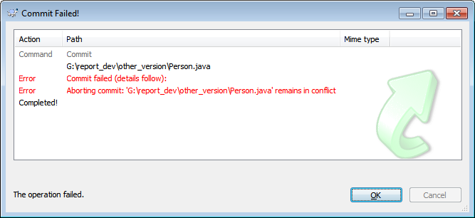
Conflicts
Where 2 sets of changes to an original file clash with each other
4 files
  Person.java (conflicted marked file)
  Person.java.mine (your work file)
  Person.java.2184 (original as checked out)
  Person.java.2185 (conflicting version)
COMP220/185
© University of Liverpool
slide <number>

Slide 20
Conflict dump (Person.java)
public class Person {
<<<<<<< .mine
private static final int ADULT_AGE=16;
=======
private static final int ADULT_AGE=21;
>>>>>>> .r2185
}
COMP220/185
© University of Liverpool
slide <number>

Slide 21
Resolving conflicts
Scrap your changes, go with the other
  svn revert Person.java
  svn update Person.java
Dump your collegues changes
  cp Person.java.mine Person.java
  svn resolved Person.java
Edit Person.java
  Remove conflicts
  svn resolved Person.java
COMP220/185
© University of Liverpool
slide <number>

Slide 22
Merging issues
Diff3 only checks for change conflicts
But programs do have dependencies
E.g. all the 3 following lines, can have impact on if statement
  int age=15;
  age=18;
  age=21;
  If (age>=21) {
  }
  It is possible for code to have a logical conflict even if they don’t have a typographic conflict
COMP220/185
© University of Liverpool
slide <number>

Slide 23
Merging and dependency
Research into merging and intelligent merge analysis
Dependency trees are developed for all 3 code(s) original1, original 2 and merge
Program slicing is used to analyse how the program behaves
Check for preservation of the old slices in new code
COMP220/185
© University of Liverpool
slide <number>

Slide 24
Good Merging procedures
Edit file as working copy
Test file with build
Merge file with all latest updates
Remove any conflicts
Test file with updated build
This ensures that code changes work with other code changes (merge works)
COMP220/185
© University of Liverpool
slide <number>

Slide 25
When not to use merge
Image files
  Make’s no sense and source code will just throw up conflict
Documents in word or PDF
  Again will throw up conflicts
If you need to merge text documents keep them a text files, build word documents from text source
COMP220/185
© University of Liverpool
slide <number>

Slide 26
Merging and doc files
In general svn will not do the merging… but
Word itself has merging features
Disadvantages
  Spend time merging formatting as well as content
  Merging not shown as part of svn repository
COMP220/185
© University of Liverpool
slide <number>

Slide 27
Rule 2 Commit early, commit often
Possible approach
  As soon as you have a new working version, commit
Benefits
  Roll backs can be back by hours instead of days
  Merges will be easier
  Testing with others will be earlier
  Forces fragmentation of task (which improves code quality)
COMP220/185
© University of Liverpool
slide <number>

Slide 28
What to store
All documentation
All source code and source files
  Everything that requires human production
  Source, images, sound files, XML
All dependency files
  JAR libraries, DLLs
  If open source, store latest build source
Database images and schema
Anything else needed to build the project
Anything needed to run the project (e.g. example Web.config files, certificates (security issue here!)
If your project depends on external downloaded code, do not rely on it being their
COMP220/185
© University of Liverpool
slide <number>

Slide 29
Versioning the database
At minimum you need to keep the schema up to date
  mysqldump -d -u someuser -p mydatabase > mydatabase.sql
If standard configuration is build into database, write config tables as well
COMP220/185
© University of Liverpool
slide <number>

Slide 30
What NOT to store
Try not to make your repository messy
Don’t store
  Object files (this can cause problems with other builds)
  Debug stuff
    Confusing
  Unused files
    Confusing
  Local config files
    Will write over other users config. Leading to application error
COMP220/185
© University of Liverpool
slide <number>

Slide 31
Revision numbering
On SVN revision numbers are global to the repository
Every time the repository is written to the revision number increases
This means that all writes in 1 commit will have the same revision number
Git does not have this concept of revision number, this can cause issues if you need it as part of your work practise
COMP220/185
© University of Liverpool
slide <number>

Slide 32
Peg revisions
It is common, when working with file systems to re-name directories and files
Can lead to confusion however
  rename develop live
  mkdir develop
Once these changes are committed the path to develop has 2 meanings
  The revisions relating to the new directory
  The revisions relating to the original directory
  The peg revision, tells svn which revision to get the path from
COMP220/185
© University of Liverpool
slide <number>

Slide 33
Adding revision information to source code
String rev=“$Revision$” // java
String date=“$Date$”
String author=“$Author”
// in web page, comments
<!--
$Revision$
$Date$
$Author$
-->
// web page, display
<div style="display: none" id=“fileRevision">
$Revision$</div>
COMP220/185
© University of Liverpool
slide <number>

Slide 34
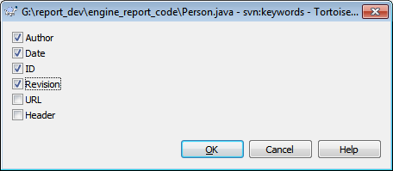
Enabling Version information properties
Tortoise SVN
Right click ..
  Tortoise Svn/Properties/Key Words
COMP220/185
© University of Liverpool
slide <number>

Slide 35
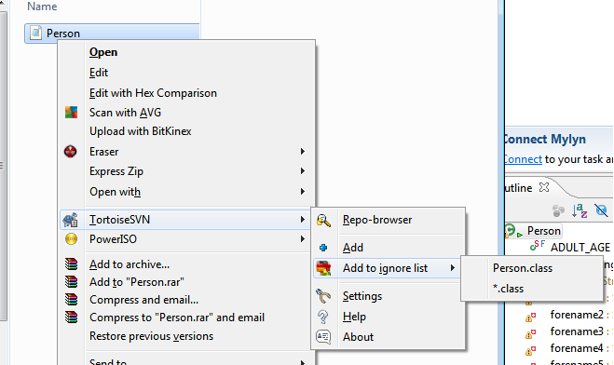
Other useful properties
svn:ignore
  Describes files to ignore by default
  So for Java project (keep svn clean of objects)
    svn propset svn:ignore *.class *.jar
COMP220/185
© University of Liverpool
slide <number>

Slide 36
Committing source code
If code testing fail
  At end of the day, still commit, remember rule 1 (slide 4)
  Do not commit to main trunk, make branch
Functionality
  If done in parts, commit but don’t integrate
  If any chance of snagging main project, keep in branch or separate build file
  Remember breaking the trunk build may stop new features being put into next release
Bug fixes
  Commit with comment for tester, link to bug report
  Have old version of code, with re-producible bug
COMP220/185
© University of Liverpool
slide <number>

Slide 37
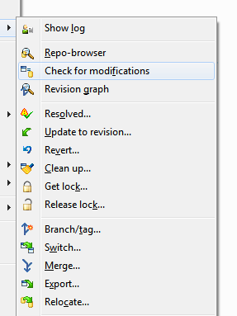
Commit reviews
Use svn check for modifications
COMP220/185
© University of Liverpool
slide <number>

Slide 38
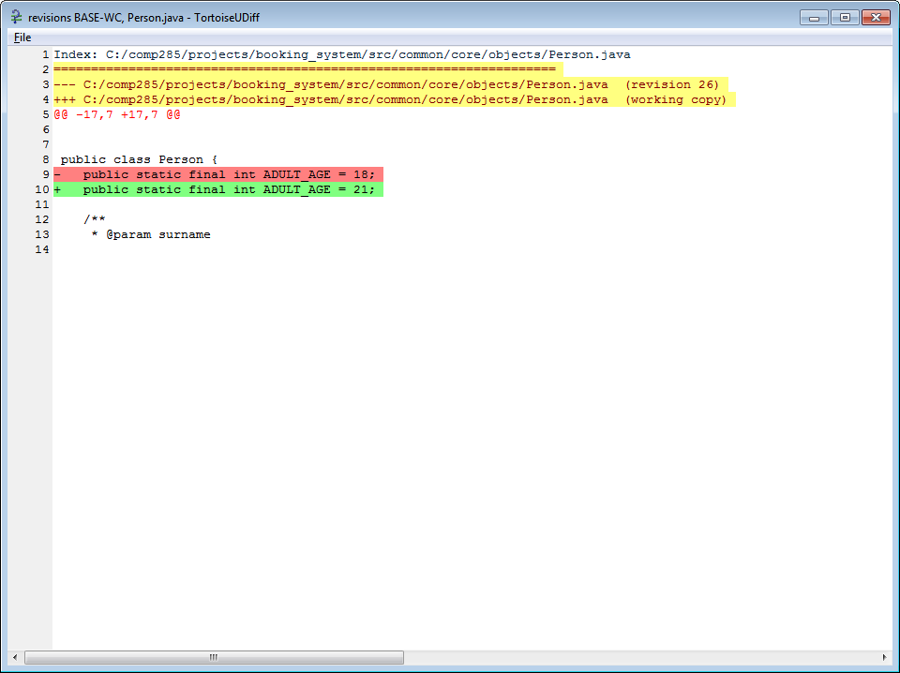
Reviewing modifications (unified diff)
COMP220/185
© University of Liverpool
slide <number>

Slide 39
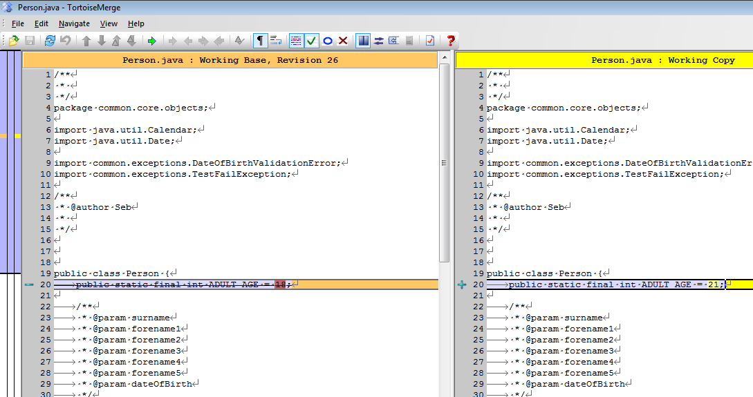

Compare with base
COMP220/185
© University of Liverpool
slide <number>

Slide 40
Autoversioning
Imagine you have a number of document writers working, who don’t want to understand version control, but need it
Auto version
  Svn repository mounted as a directory (like a network drive), using protocol such as WebDav “Web Distributed Authoring and Versioning”
  When a file is opened by the first user it is locked as read-only for others
  Every write is then done as an auto-commit
COMP220/185
© University of Liverpool
slide <number>

Slide 41
Problems with Autoversioning
Many commits
  Some editors such as Word will do auto saving
  Makes the change log, very long hard to follow
Enforced locking
  Lock problems with sequential working etc.
No comments
  User has to add comments to document itself, if they want to track changes
  Not useful for code development
COMP220/185
© University of Liverpool
slide <number>

Slide 42
Branches and tags
Branch
  New version of trunk which is used for development
  Can be merged back to trunk when finished
Tag
  Snap shot of trunk
  Not developed with
  Often seen as release candidates or archives
COMP220/185
© University of Liverpool
slide <number>

Slide 43
Branching and merging how to
Update current working trunk (svn update)
Commit all current changes
Using svn copy make copy of trunk to branch directory
  svn cp svn://svnserver.com/svn/repository/trunk svn://svnserver.com/svn/repository/branches/cluster_support_version -m "Branching from trunk to support clustering "
Now switch your local trunk to this new branch
  svn switch svn://svnserver.com/svn/repository/branches/clustering_support_version
You can now work on this new version, without causing problems with the main branch
COMP220/185
© University of Liverpool
slide <number>

Slide 44
Managing your branch
Regularly update your branch from main tree and test and resolve conflicts
  If not it will be harder to merge back later
Merging from trunk
  svn merge svn://svnserver.com/svn/repository/trunk
Resolve all conflicts or revert
Build and test
Re-commit merged working copy to branch repository
COMP220/185
© University of Liverpool
slide <number>

Slide 45
Merging back to the trunk
First do a merge from trunk to your branch as done before
Test new build
Once build has completed tests
Get working copy of trunk from svn
  svn checkout
Now merge your branch with that working copy
  svn merge --reintegrate ^/svn/repository/branches/cluster_support_version
COMP220/185
© University of Liverpool
slide <number>

Slide 46
Integration/development styles
Feature branches
  Branch for each feature
  Integration can be complex
  Testing is isolated
Continuous integration with trunk
  Keeps testing tight
  Brings up integration problems early
  Breaks the trunk build
Feature toggles
  All features are switchable on/off so that problematic features can be isolated
  Test mode verses live mode
COMP220/185
© University of Liverpool
slide <number>

Slide 47
Release branches
At countdown to release
  Copy trunk to release branch, release 1.0
Two teams
  Test/develop work on debug/test of 1.0, feature list is frozen
  Developer’s work on new features on trunk
After release, 1.0 is marked as snapshot
Trunk is then copied to 2.0 and process start’s again
COMP220/185
© University of Liverpool
slide <number>

Slide 48
Multiple branching issues
Each branch can develop conflicts with other branches without knowing it
  Due to branches synching with trunk not each other
Can lead to duplication of work
  Communication issues
Ideally need for
  Highly de-coupled code and architecture
COMP220/185
© University of Liverpool
slide <number>

Slide 49
Change lists
Allows you to group files together for operations and status
Change list example
  Fix css style sheets to iPhone display
    svn changelist css-iphone main.css ui.css
    svn changelist css-iphone game.css
You can now use the change list to commit the files together
  svn commit -m "Fix style sheets for iPhone." --changelist css-iphone
COMP220/185
© University of Liverpool
slide <number>

Slide 50
Hooks
Can be used to automatically send email or other notifications when svn receives commons
Example
  Post or pre-commit hooks can keep development team updated on updates
Hooks are usually web call backs, you need a script (php or aspx) to process the command
COMP220/185
© University of Liverpool
slide <number>

Slide 51
Email hook code aspx example
protected void Page_Load(object sender, EventArgs e)
{
String body="Changed files "+Request.Params["changed"];
body=body+" Revision "+Request.Params["youngest"]+" description :"+Request.Params["description"]+" log :"+Request.Params["log"];
String subject = "Commit from " + Request.Params["author"] + " for project " + Request.Params["project"];
String from = "sebcoope1@gmail.com";
String to = "coopes@liv.ac.uk";
System.Net.Mail.MailMessage mess = new System.Net.Mail.MailMessage(from, to,subject,body);
SmtpClient client = new SmtpClient("smtp.gmail.com", 587);
NetworkCredential Credentials = new NetworkCredential("sebcoope1@gmail.com", “secret"); // put your gmail creditials here!
client.Credentials = Credentials;
client.EnableSsl=true;
client.Send(mess);
}
COMP220/185
© University of Liverpool
slide <number>

Slide 52
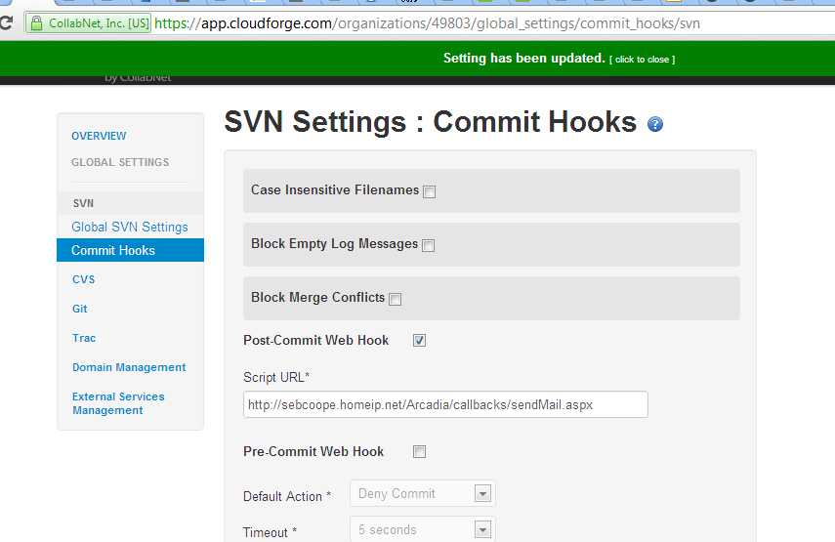
Configuring the commit hook
COMP220/185
© University of Liverpool
slide <number>

Slide 53
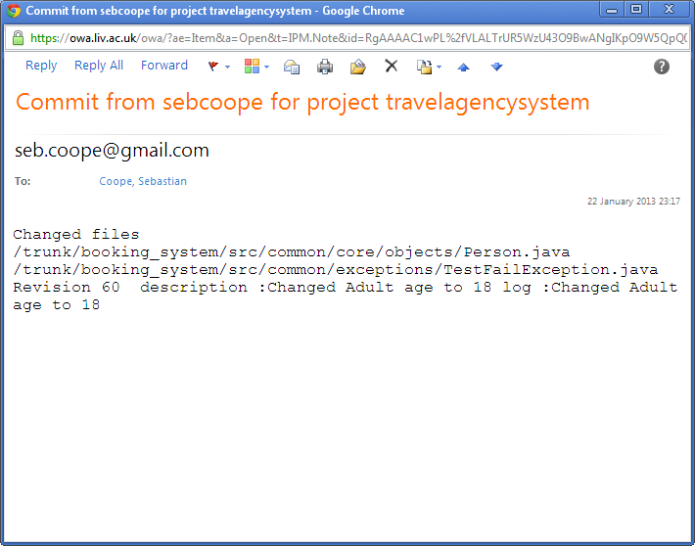
Email hooks
COMP220/185
© University of Liverpool
slide <number>

Slide 54
Summary
Source code control essential for any large scale project
Provides code security and communications
Not a substitute for talking to others in your team
Makes it easier to manage
  Change
  Bugs
  Releases
Needs effective work practises to be useful
Different modes of use, lock or merge
COMP220/185
© University of Liverpool
slide <number>

